Slide 1
Python Debugging
with PUDB, Charles, and cProfile
aka ARG! WHY AREN’T YOU WORKING????
Christopher Beacham / Lady Red,
Sr. Engineer @ Hipmunk
Created for Noisebridge Python Class, share freely

Slide 2
Debugging!
Whether you’ve just started, or have written python for years, you probably have bugs in your code. These tools increase your visibility into what your code is doing, so you can spot errors proactively.
Tools we’ll cover:
PUDB - Interactive ncurses in-terminal debugger.
Charles Proxy - Web debugging proxy. Hella useful. Nagware
cProfile + SnakeViz - built-in python profiler and visualization tool

Slide 3
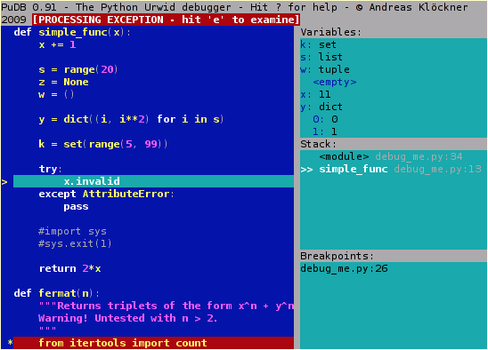
PUDB
PUDB is my favorite debugger. It’s very similar to pdb and ipdb, but it show you everything in scope, your code, and a terminal.
If you use print statements to debug now, this can give you a lot more visibility
Install: pip install pudb
Invoke import pudb; pudb.set_trace()
Docs:https://documen.tician.de/pudb/misc.html

Slide 4
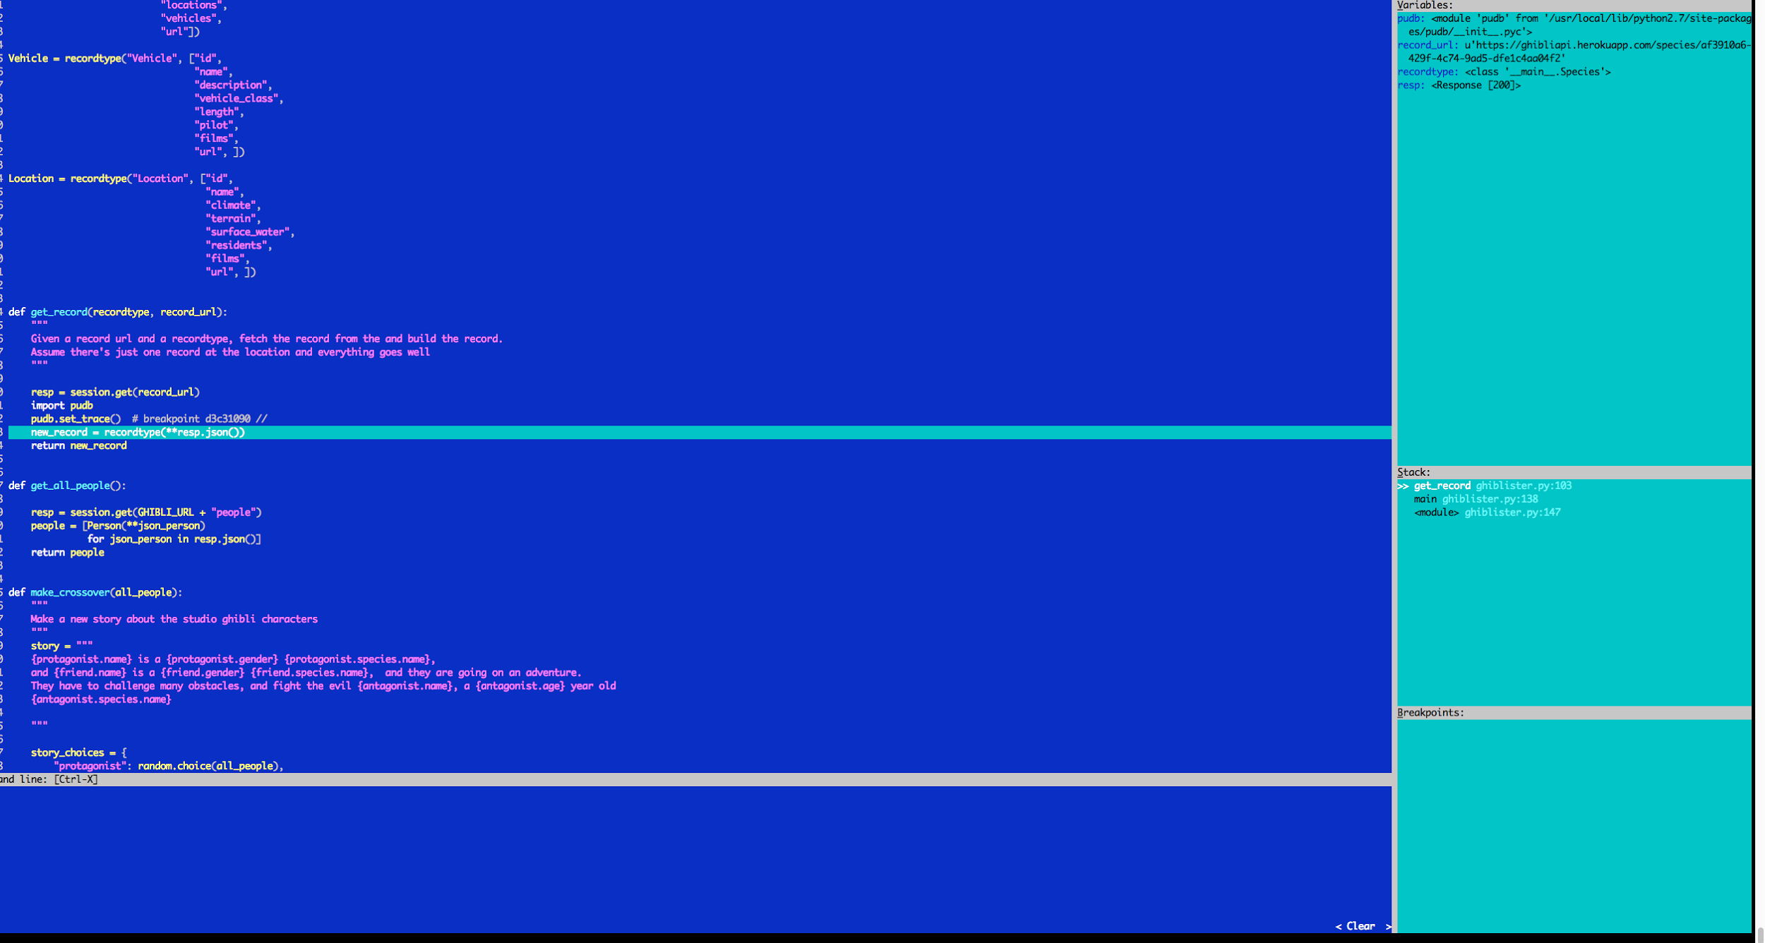
? - help panel (lists commands)
↑/↓ -> Move selected line
←/→ - select variables or code
c - continue
s - step into
n - step over
t - run to cursor
u/d - up/down stack frames!
b - set/unset breakpoint
o - see program output
! - go to ipython
Ctrl x - see terminal

Slide 5
Tips and tricks
It looks like a lot of commands but you get them pretty quickly. Most are shared with pdb/ipdb.
? to get help menu, ctrl p to edit preferences
Set your variable stringifier to str or repr (it defaults to type)
You can set a ‘watch’ variable from the variable box. It can be an expression and it will show you it’s value. So you could watch for a condition to become true, or just highlight a variable
I like set my shell to ipython, there are a few options.
If you use nose testing, you can drop into pudb on failures with the nose-pudb package
You can wrap/unwrap long variables so they don’t take up so much of your screenspace.

Slide 6
What is Charles?
Web debugging proxy
It shows http/https traffic that passes through the proxy
This means it can break SSL if you want. (Man in the middle)
You can:
monitor traffic
Read JSON/XML/Soap in a human readable way
repeat requests (excellent for api developing)
modify requests live
intercept and modify responses
Throttle to mimic low-speed connections like 3g or dialup
Record and save traffic (excellent for jira tickets)
Load testing

Slide 7
What Charles is NOT:
It’s not a general purpose packet monitor.
Only speaks HTTP, HTTPS, and SOCKS
Use wireshark or ettercap for that
It doesn’t display HTML
It can validate it, but that’s it.
Should use google chrome tools for that.
Charles is comparable to the google chrome network tab, but more fleshed out.
It’s not a server
You can’t respond to requests from charles, although you CAN edit the responses to whatever you want.
If you want a very simple server tool, you can use the command line tool NetCat
nc -l port # simple server
nc domain port # simple client

Slide 8
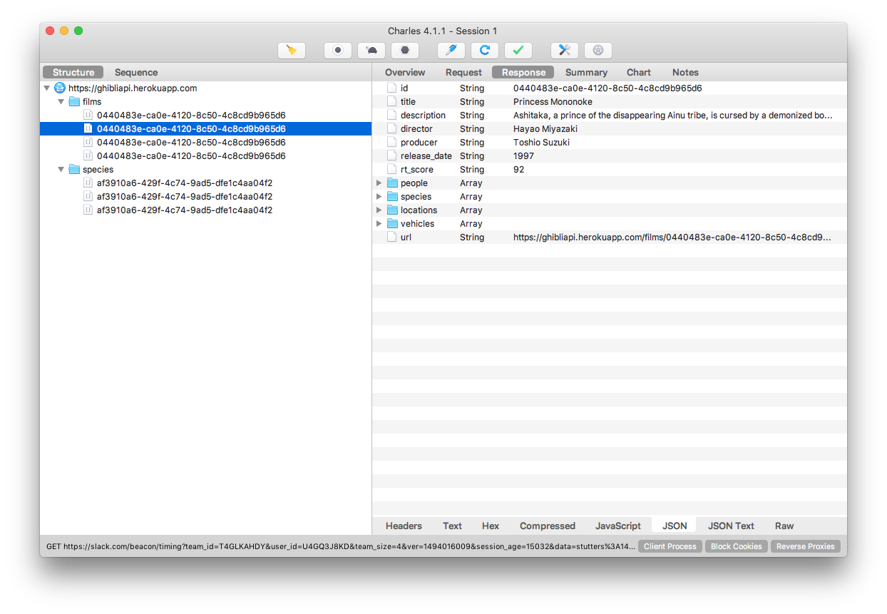

Slide 9
Setting up Charles
Download from https://www.charlesproxy.com
You should give it permission to set a Mac OS X Proxy
It’ll do turn this proxy on whenever it starts or quits.
It will ask about a firefox proxy, I’ve never bothered with that.
If you want it to break SSL, it makes it’s own SSL certificate. You can keep telling your browser to trust it, or set your computer to always trust it. (SSL Proxying > Install Charles Root Certificate)
If you want to use it with a phone, you’ll have to configure that and install the charles ssl cert on the phone. Deets here: https://www.charlesproxy.com/documentation/using-charles/ssl-certificates/
You gotta tell it which domains it should break SSL on

Slide 10
Monitor Traffic Demo
For a basic demo, lets just open charles and click the ‘record’ button. If we open a web browser we should be able to see the requests coming in real time. Try a hipmunk flight search.
There are two views - structure and sequence.
Sequence - filterable list of requests as they come in. sort by time,path, code, whatever.
Structure - see requests by domain in a tree-structure.
Things to show:
Request - query, headers, cookies, curl command, repeat, edit
Response - headers, json, compressed,
Summary/chart (select multiple for gant chart)
Saving a request/response or entire ses sion (great for jira tickets!)
Trash can clears, record button toggles recording.

Slide 11
Other web tools
As previously mentioned:
Command line swiss army knife -Netcat (nc)
Packet analysis - Wireshark, ettercap, tcpdump
Network requests from one page - google chrome network tab
Web debugging proxys - Charles, Fiddler, mitmproxy (CLI)
Fiddler appears to be very similar to charles. Used to be windows only but now there’s a mac beta. I think it has scripting ability. I haven’t used it.
http://www.telerik.com/fiddler

Slide 12
Charles is nagware
After you install it, it’ll keep bugging you until you buy a license.
I think it’s just one developer building it, so yeah, if you find it useful, it’s a good cause to buy a license and support his work.

Slide 13
Profiling
Profiling is separate from debugging. It’s how to analyze your code’s performance and find areas that are taking longer than they ought to.
Interpreting a profiler output is almost an art. You have to know how long all of these functions ought to take, which requires knowledge of what they’re doing under the hood, and also of how the program is using them. You likely won’t be able to productively profile code until you are familiar with it.
Always profile before making performance-related improvements. Your assumptions about what is taking the most time are often wrong. Speeding up code that is already fast is useless!

Slide 14
cProfile!
Python has 3 built-in profilers, but cProfile is the most commonly used one.
It’s in the standard library.
python -m cProfile [-o output_file] [-s sort_order] myscript.py
Two output formats - binary and human readable.
Output can be confusing due to limitations of the profiler

Slide 15
“Human readable” output
517376 function calls (513805 primitive calls) in 2.450 seconds
Ordered by: cumulative time
ncalls tottime percall cumtime percall filename:lineno(function)
1 0.000 0.000 2.450 2.450 profile:0(<code object <module> at 0x103f2a1b0, file "ghiblister.py", line 24>)
1 0.003 0.003 2.448 2.448 ghiblister.py:24(<module>)
1 0.001 0.001 1.857 1.857 __init__.py:42(<module>)
1 0.005 0.005 1.703 1.703 utils.py:10(<module>)
1 0.005 0.005 1.664 1.664 compat.py:5(<module>)
1 0.003 0.003 1.586 1.586 __init__.py:99(<module>)
1 0.000 0.000 1.552 1.552 decoder.py:2(<module>)
1 0.000 0.000 1.549 1.549 scanner.py:2(<module>)
1 0.000 0.000 1.546 1.546 scanner.py:4(_import_c_make_scanner)
1 0.000 0.000 1.545 1.545 _speedups.py:1(<module>)
1 0.002 0.002 1.545 1.545 _speedups.py:1(__bootstrap__)
1 0.012 0.012 1.541 1.541 pkg_resources.py:15(<module>)
294 0.006 0.000 0.956 0.003 pkg_resources.py:576(add_entry)
1 0.000 0.000 0.869 0.869 pkg_resources.py:534(_build_master)
1 0.001 0.001 0.869 0.869 pkg_resources.py:521(__init__)
276 0.002 0.000 0.736 0.003 pkg_resources.py:1974(find_eggs_in_zip)
308 0.002 0.000 0.704 0.002 pkg_resources.py:1512(has_metadata)
186 0.001 0.000 0.694 0.004 pkg_resources.py:1869(_has)
237 0.001 0.000 0.646 0.003 pkg_resources.py:1749(zipinfo)
237 0.004 0.000 0.645 0.003 pkg_resources.py:1686(load)
92 0.015 0.000 0.622 0.007 pkg_resources.py:1658(build)
1 0.001 0.001 0.578 0.578 ghiblister.py:144(main)
61 0.001 0.000 0.569 0.009 sessions.py:472(get)
61 0.002 0.000 0.568 0.009 sessions.py:392(request)
60 0.001 0.000 0.541 0.009 ghiblister.py:94(get_record)
92 0.001 0.000 0.484 0.005 pkg_resources.py:1711(__new__)
92 0.002 0.000 0.483 0.005 zipfile.py:726(__init__)
92 0.204 0.002 0.479 0.005 zipfile.py:803(_RealGetContents)
745 0.004 0.000 0.377 0.001 re.py:230(_compile)
61 0.004 0.000 0.373 0.006 sessions.py:542(send)
97 0.002 0.000 0.371 0.004 sre_compile.py:567(compile)
98 0.001 0.000 0.371 0.004 re.py:192(compile)
61 0.002 0.000 0.289 0.005 adapters.py:329(send)
1 0.001 0.001 0.267 0.267 pkg_resources.py:864(subscribe)
176 0.001 0.000 0.266 0.002 pkg_resources.py:2924(<lambda>)
176 0.002 0.000 0.265 0.002 pkg_resources.py:2468(activate)
100/97 0.001 0.000 0.242 0.002 sre_parse.py:686(parse)
I find it’s best to sort by cumtime (cumulative time)
Difficult to distinguish which times are additive, and which times are nested.
Gets confusing for anything more than the simplest program

Slide 16
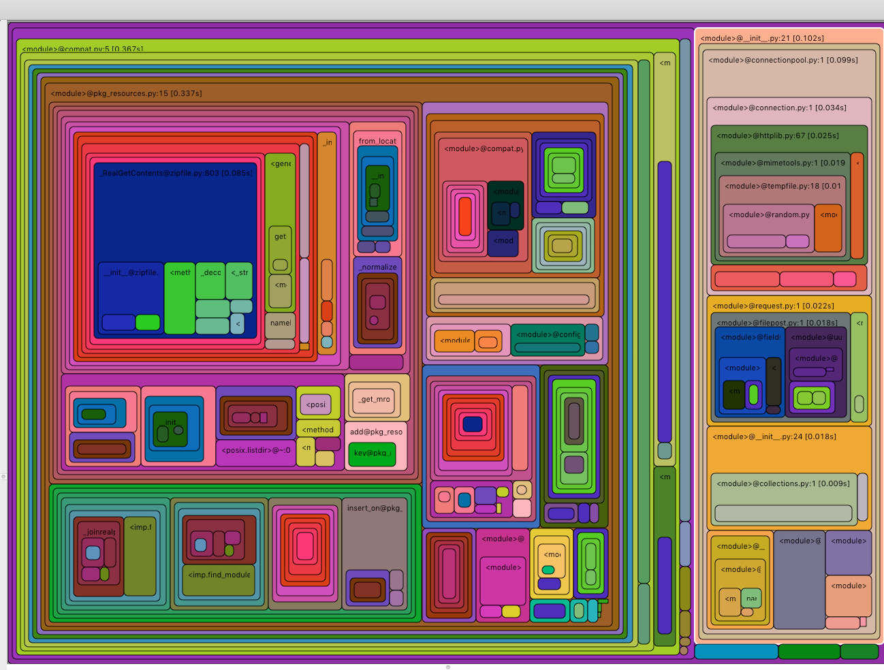
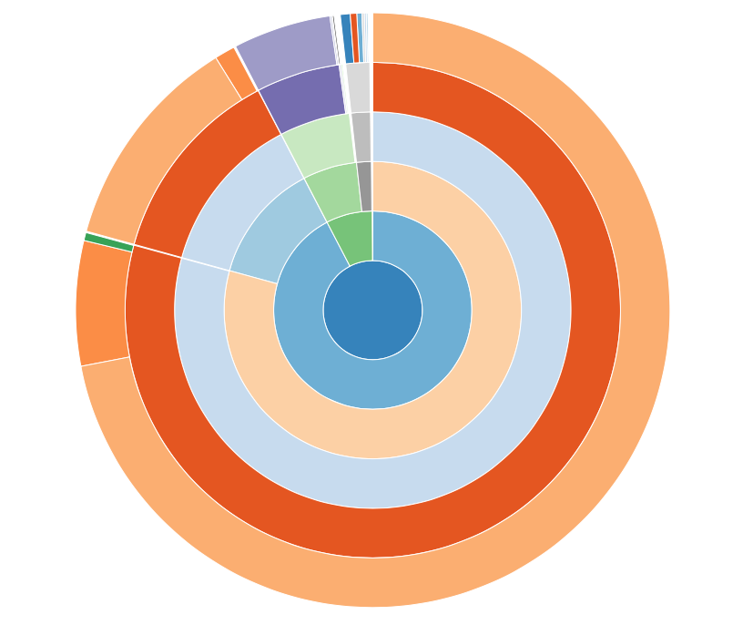
SnakeViz + binary output
cProfile can make binary output that can be read by several tools. I like runsnakerun and snakeviz

Slide 17
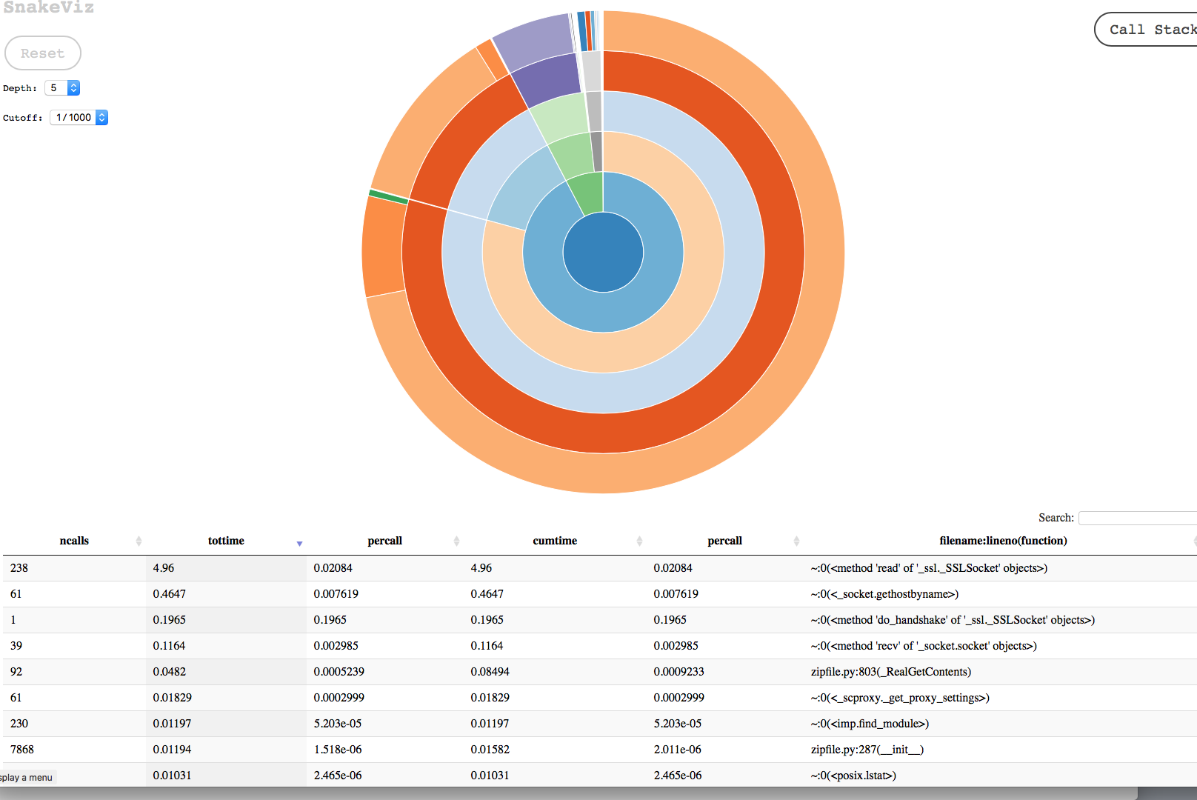

Slide 18
Profiling Tips and Tricks
The profiling visualizers can often take a lot of profiling traces as arguments. Try passing them a glob like “snakeviz *” to profile all the output files in a directory
Profile visualizers don’t have the full stack trace on each sample, so if you have a complicated function call pattern (say, foo and bar both call baz), you can see this strange behavior where the children take longer than the parents. I have included an example in call_graph_example.py
Profiling is tough, it can be hard to make big wins, but it can tell you where to focus your attention

Slide 19
Memory Profiling
It’s possible to see the memory usage of a running python thread.
from guppy import hpy
heap = hpy()
print heap.heap()
Interpretation is out of scope of this talk
http://smira.ru/wp-content/uploads/2011/08/heapy.html
http://guppy-pe.sourceforge.net/guppy.html
Partition of a set of 244600 objects. Total size = 22893632 bytes.
Index Count % Size % Cumulative % Kind (class / dict of class)
0 75532 31 6915840 30 6915840 30 str
1 35447 14 3452576 15 10368416 45 tuple
2 100063 41 2401512 10 12769928 56 int
3 712 0 2143168 9 14913096 65 dict (no owner)
4 7868 3 1573600 7 16486696 72 zipfile.ZipInfo
5 2 0 819808 4 17306504 76 guppy.heapy.heapyc.NodeGraph
6 281 0 801368 4 18107872 79 dict of module
7 5252 2 672256 3 18780128 82 types.CodeType
8 5102 2 612240 3 19392368 85 function
9 563 0 508184 2 19900552 87 type
<258 more rows. Type e.g. '_.more' to view.>

Slide 20

Homework!
I wrote an example integration with Studio Ghibli Api. It’s called ghiblister.py
my script sucks. It’s network inefficient, and super slow. Can you make it better? It’s a little sandbox you can use to play with these tools, and make a Studio Ghibli story builder if you want.
I included some profiles you can look at, or you can make your own.

Slide 21
Links
Charles https://www.charlesproxy.com
PUDB https://documen.tician.de/pudb/
cProfile https://docs.python.org/2/library/profile.html
SnakeViz (for reading cProfile output) https://jiffyclub.github.io/snakeviz/

